Slide 1
Extremophiles
Alice Chen

Slide 2
Schedule
3:05 - 3:35 Presentation
3:35 - 4:00 Research
4:00 - 4:25 Present findings + Fill out our table
4:25 - 4:35 Break
4:35 - 4:40 Introduce Skype
4:40 - 5:00 Group Discussion
5:00 - 5:35 Skype Dr. Carlos Mariscal

Slide 3
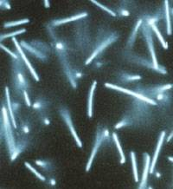
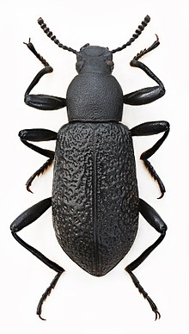
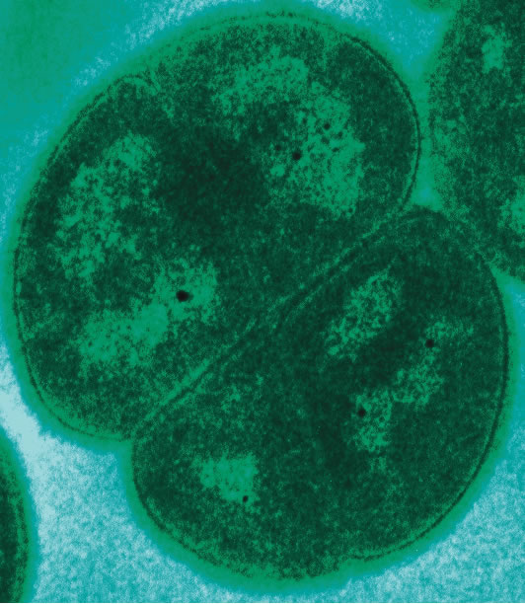
Background
Big Picture:
What are the definition and limits of life?
What are the molecular mechanisms of adaptation?
http://wishart.biology.ualberta.ca/BacMap/cgi/getSpeciesCard.cgi?accession=NC_003551&ref=index_12.html
https://en.wikipedia.org/wiki/Upis_ceramboides
https://en.wikipedia.org/wiki/Deinococcus_radiodurans

Slide 4
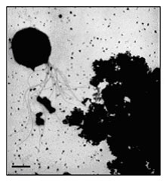
Paper Summary - Kashefi and Lovley
Upper temperature limit for life gives us information on origin of life on hot, early Earth and life elsewhere in the universe
Lots of Fe(III) in hydrothermal vents
Fe(III) as the final electron acceptor in the ETC was the first form of respiration
Their experiment -
Microorganisms on Fe(III) in water from an active black smoker vent
Monitor cell growth and reduction of Fe(III)
Found strain 121 (Geogemma barossii) from the experiment
Grows optimally in a temperature range of 85 to 121℃
Uses Fe(III) as electron acceptor
https://microbewiki.kenyon.edu/index.php/Geogemma_barossii

Slide 5
Paper Summary - Rothschild
Extremophiles help with life outside Earth findings, origin of life hypothesis, biotech industry
Different types of extremophiles and their mechanisms of adaptation
Temperature
Pressure
Dryness
Salinity
pH
Various extreme environments on Earth and in space
Deep sea
Desserts
Snow, ice
Mars
Space
Extremophiles have contributed tremendously to many fields: evolutionary biology, molecular biology, chemical synthesis, agriculture, detergents, health, etc.

Slide 6
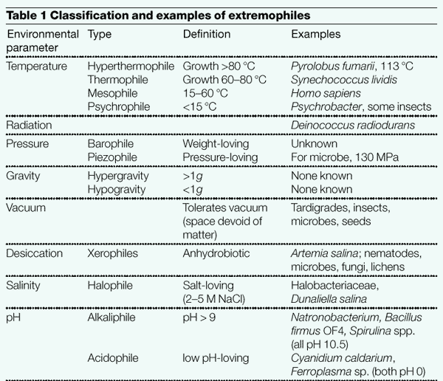
Adapting Rothschild’s Table 1
Extreme Limits and Adaptive Mechanisms of Extremophiles
Extremophile | Limits (Examples) | Mechanisms of Adaptation
Thermophiles
Psychrophiles
Halophiles
Piezophiles (barophiles)
Rothschild 2001

Slide 7
Thermophiles
Upper temperature limit of life has been pushed
Pyrolobus fumarii (Rothschild 2001)
Strain 121 (Kashefi and Lovley 2003)
Methanopyrus kandleri (Takai 2008)
Possible!
Extremozyme, proteins that can function in the extreme environments, allow for extremophiles to thrive
Classification:
Simply Thermophiles | 50–64 °C
Extreme thermophiles | 65–79 °C
Hyperthermophiles | >80 °C
Obligate thermophiles | Require high temperature
Facultative thermophiles | Thrive in high and lower temperatures

Slide 8
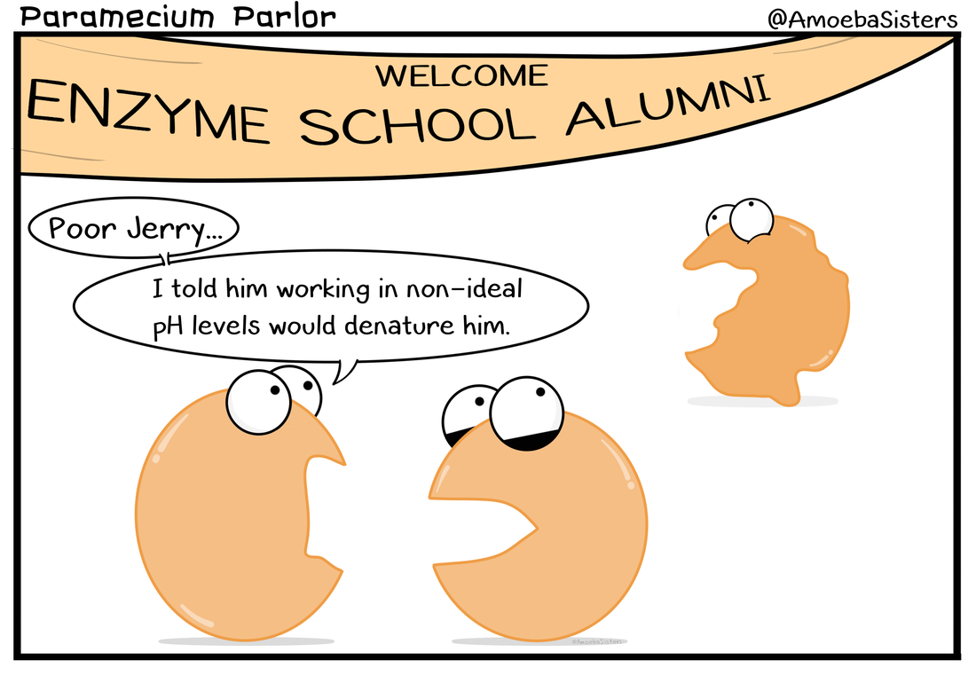
Thermophiles
In order to adapt to high temperatures,
Membrane fluidity
Monolayer better than bilayer
Saturated better than unsaturated lipids
Protein function
Charged amino acids form ion pairs
Cell liquid
High pressure
DNA stability
temperatures

Slide 9
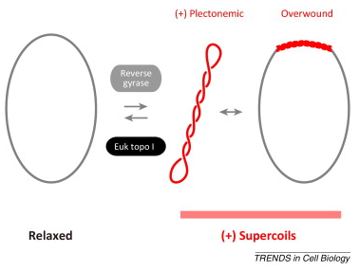
Thermophiles
Nucleic Acid Stability
GC content
Salt screens
Reverse DNA Gyrase
Overwinds DNA
Only found in thermophiles
Extensive methylation of DNA
http://www.sciencedirect.com/science/article/pii/S0962892414001044

Slide 10
Research in Pairs
Extremophile | Limits (Examples) | Mechanisms of Adaptation
1. Thermophiles | 122°C with Methanopyrus kandleri | Saturated lipids membrane, ion pairs, reverse DNA gyrase
2. Psychrophiles
3. Piezophiles (barophiles)
4. Halophiles
What are the known possible metabolisms in thermophiles?
How do various psychrophiles withstand freezing temperatures?
What is the current research on the upper pressure limit of life and the mechanisms of adaptation?
What is the current research on the upper limit with salinity and the mechanisms of adaptation?

Slide 11
BIO BREAK

Slide 12
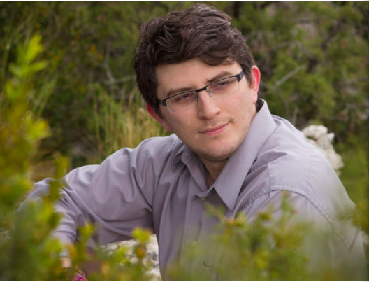
Skype: Carlos Mariscal
Professor in the Philosophy Department at the University of Nevada
Member of the Ecology, Evolution, and Conservation Biology Program
Got his PhD from Duke with Prof. Daniel McShea
http://carlosmariscal.com/
His work and interests -
philosophy, biology, astrobiology, microbiology, how philosophy plays its role in those fields
life in the Universe, origins of life on Earth
journalism
One of the only philosophers of astrobiology

Slide 13
Group Discussion Questions
What do you think extremophiles can tell us about the origin of life hypotheses?
If the idea of extremophiles makes life existing elsewhere in space more plausible, how do we discover this life and what do we do when we discover this life?
Dr. Mariscal’s work on the definition of life

Slide 14
Skype!

Slide 15
Thanks!

